Slide 1
Dynamics
MS864M

Slide 2
Dynamics
Dynamics describes the relationship of the motion of an object to the forces that cause the motion.
Dynamics answers questions such as why it is harder to control a car on wet ice than on a dry surface or how a rocket is able to propel itself as it moves upward.
We will study important laws of physics which describe nature in the macroscopic world.

Slide 3
Force
A force is an interaction between two bodies or between a body and its environment.
E.g. the gravitational force between two masses, m₁ and m₂, separated by distance r is given by
If either object disappears, the force between them also disappear.
m₁
m₂
r

Slide 4
Long range force vs contact force
Contact force arises when there is contact between objects such as a physical push or a pull.
Long-range force is felt even when the objects are not in physical contact (such as the gravitational pull between the Earth and the Moon).
The gravitational force that earth exerts on you is known as your weight .

Slide 5
Contact force – normal force
When an object pushes on a surface, the surface pushes back on the object.
The force exerted by the surface on the object is known as the normal force .
Normal means perpendicular to the surface.
The magnitude of the normal force is not always equal to the magnitude of the weight of the object.
E.g. if the object is on an inclined surface, its normal reaction is N = Wcosθ.
θ

Slide 6
Contact force – friction
Friction occurs when a surface resists motion of an object.
The direction of the frictional force is opposite to the direction of motion of the object.
Direction of frictional force
Direction of applied force

Slide 7
Contact forces – tension and compression
When a rod is stretched, a pair of equal and opposite forces known as tension force appears in the rod.
When the rod is compressed, a pair of equal and opposite forces known as compression force appears in the rod.
Pulling force
Pushing force

Slide 8
Superposition of forces
The principle of superposition of forces states that any number of forces applied at a point on a body have the same effect as a single force.
This single force is the net or resultant force.
If the net force is zero, the object is said to be in equilibrium.
Each component of the net force is zero, i.e.

Slide 9
Newton’s first law of motion
Every body continues in its state of rest or uniform motion in a straight line unless a net force acts on it to change that state.
You do not need a force to sustain motion!
Inertia is the property of a body which resists change in its state of motion.
The larger the mass, the greater its inertia.

Slide 10
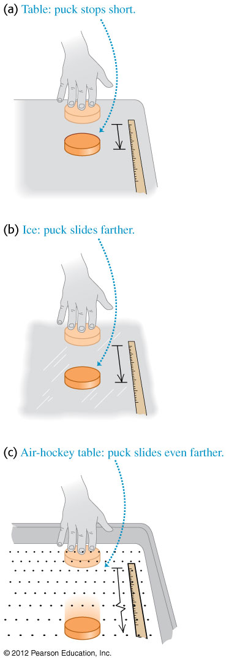
Newton’s first law of motion
In the scenarios below, the puck moves through different distances because of different frictional forces.
If friction is totally absent, the puck moves with constant velocity i.e. with constant speed in a straight line.

Slide 11
Newton’s second law of motion
This law states that the net force acting on that body is directly proportional to the of acceleration of a body.
Newton’s second law of motion can be expressed as
The above equation is valid only if the mass is constant.
In component form .

Slide 12
Definition of one newton
Newton’s second law is used to define the SI unit of force.
One newton (N) is the net force that gives an acceleration of one metre per second squared to a mass of one kilogram.
Mathematically, 1 N = 1kg m/s²

Slide 13
Weight of an object
Note that mass and weight are not the same.
Since an object accelerates with magnitude g under gravity, according to Newton’s second law, the force acting on it must be, .
This force is called the weight of the object, .

Slide 14
Newton’s third law of motion
It states that if body A exerts a force on body B (action on B), then B exerts an equal but opposite force (reaction of B) on A.
The two equal and opposite forces acting on A and B are known as an action-reaction pair.
Mathematically we write Newton's third law as

Slide 15
Newton’s laws are not valid in a non-inertial frame
Consider person on roller skates standing on a bus that is initially moving at a constant velocity.
If suddenly the bus speeds up or slows down, the person starts moving backward or forward.
Newton’s second law does not seem to be obeyed as without any net force on the person, the velocity of the person changes.
This because the bus is accelerating with respect to earth and is not an inertia frame of reference.

Slide 16
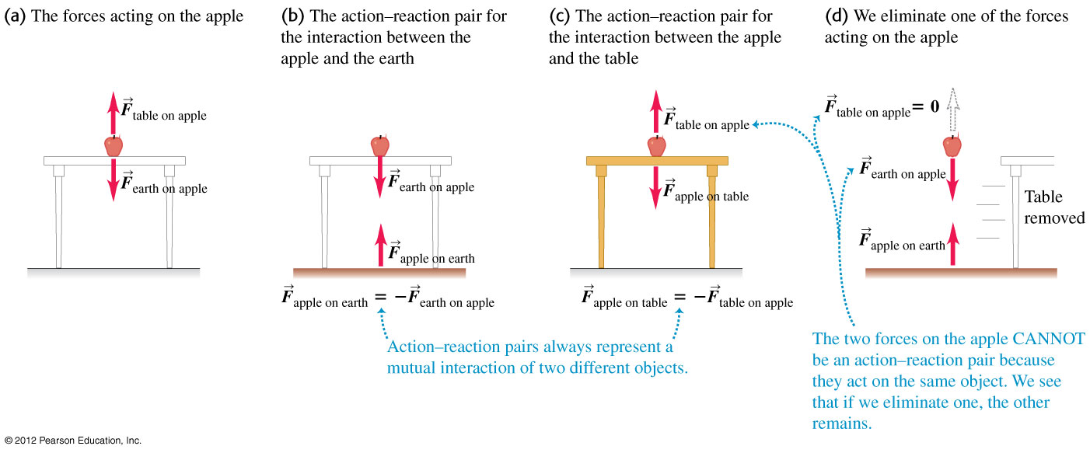
Example 1
An apple sits at rest on a table in equilibrium.
(i) What forces act on the apple?
(ii) What is the reaction force to each of the forces acting on the apple?
(iii) What are the action-reaction pairs?

Slide 17
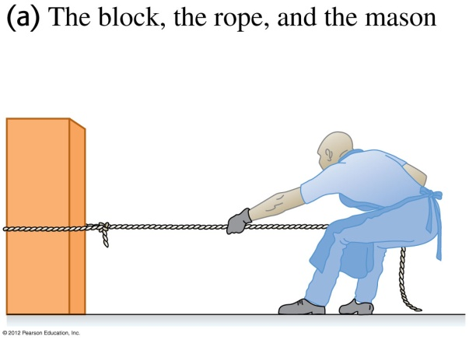
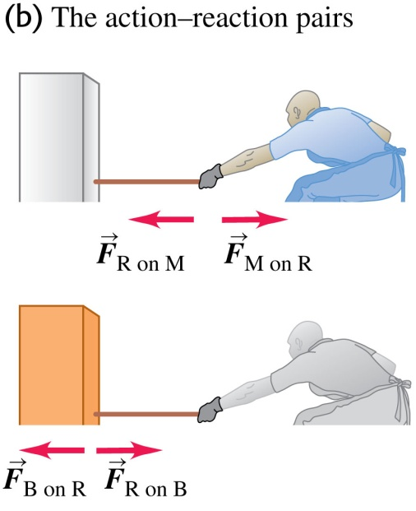
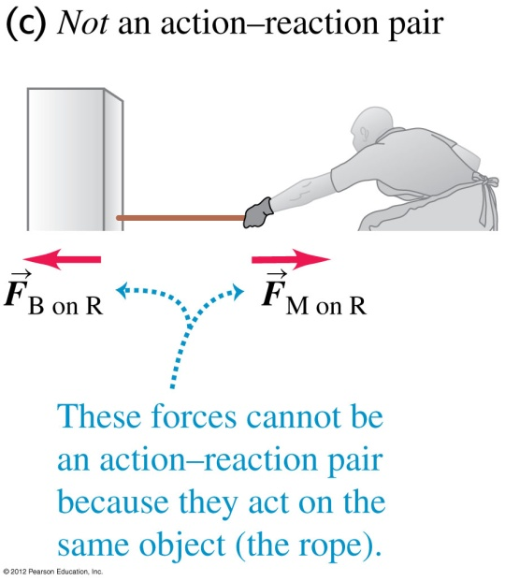
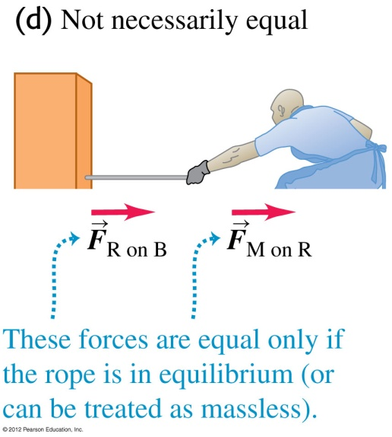
Example 2
A stone mason drags a marble block across a floor by pulling on a rope attached to the block (see figure). The block is not necessarily in equilibrium.
(i) How are the various forces related?
(ii) What are the action-reaction pairs?

Slide 18
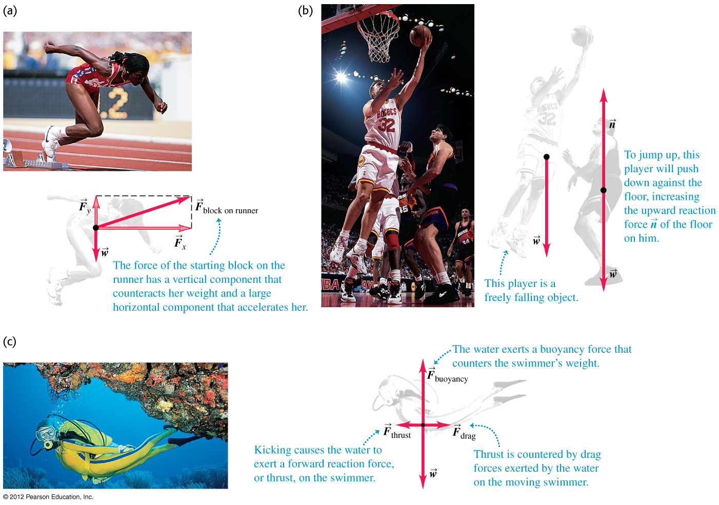
Free-body diagram
We choose an object of interest and draw all the forces acting on it due to other bodies. Forces that the object of interest exerts on other bodies are not included.

Slide 19
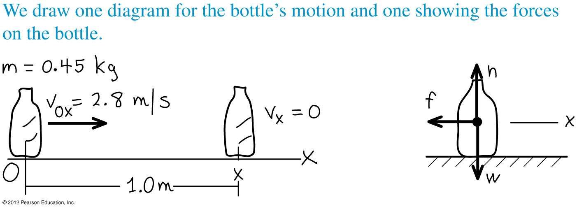
Example 3
An object with mass 0.45 kg with initial velocity of 2.8 m/s moves on a rough table. The friction force slows down the object which comes to rest after travelling 1.0 m. What are the magnitude and direction of the friction force acting on the object? You can assume a constant friction force.
Notes:
F = -1.8N. The negative sign indicates that the direction of the force is opposite to the motion.

Slide 20
Example 4
Two blocks A and B are connected as in figure below on a smooth horizontal floor and pulled to the right with an acceleration of 2.0 m/s² by force P. If M_{A} = 50 kg and M_{B} = 10 kg, what are the values of T and P?
If we consider mass B, it is acted on by only the tension T. If we consider mass A, it is acted on by both the tension T and the force P.
B
A
T
T
10 kg
50 kg
P
B
A
T
T
10 kg
50 kg
P

Slide 21
Example 4 - continue
For mass B, using Newton’s second law
For mass A, using Newton’s second law

Slide 22
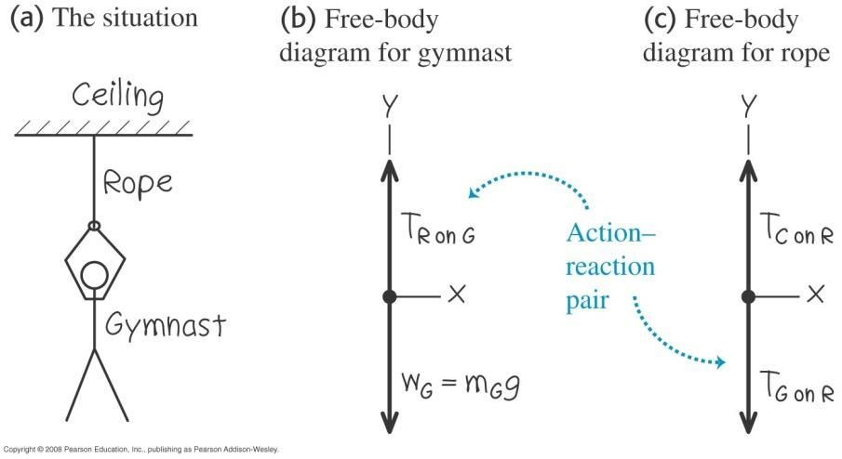
Example 5
a) A gymnast with mass m_{G} = 50.0 kg suspends herself from the lower end of a hanging rope of negligible mass. The upper end of the rope is attached to the ceiling.
i) What is the gymnast’s weight?
ii) What force (magnitude and direction) does the rope exert on her?
iii) What is the tension at the top of the rope?
b) Find the tension at each end of the rope if the weight of the rope is 120 N.
Notes:
(a) (i) W_{G} = 490 N (ii) T_{R on G} = 490 N (iii) T = 490 N
(b) T = 610 N

Slide 23
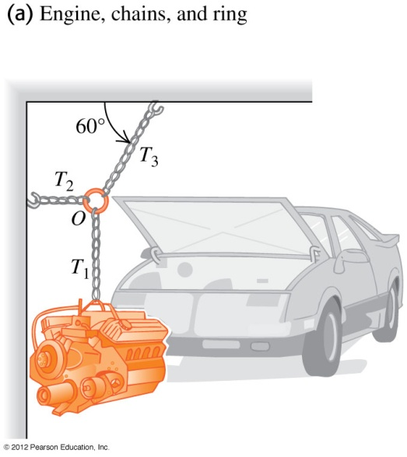
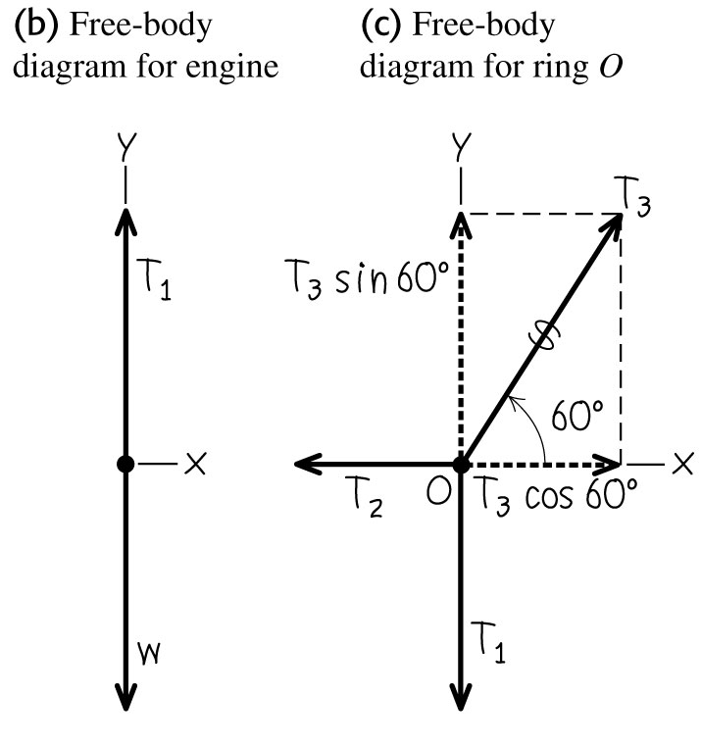
Example 6
A car engine with weight w hangs from a chain that is linked at ring O to two other chains that are attached to the ceiling and wall respectively (see figure). Find expressions for the tension in each of the three chains in terms of w. The weights of the ring and chains are negligible compared with the weight of the engine.
Notes:
T₁ = w, T₂ = 0.58 w, T₃ = 1.2 w

Slide 24
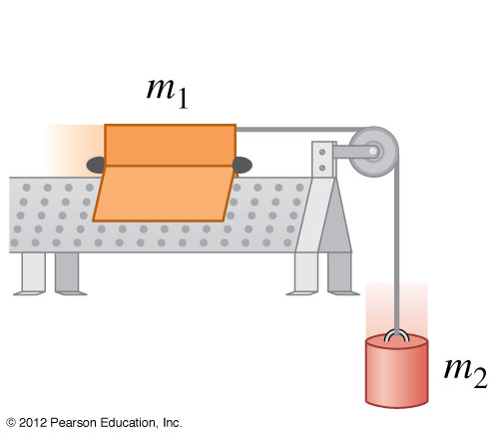
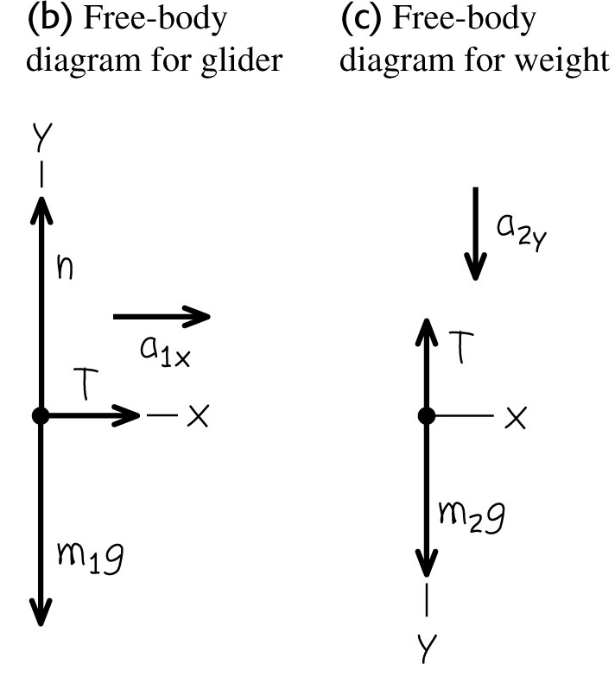
Example 7
An air-track glider with mass m₁ moves on a level, frictionless surface. The glider is connected to another object of mass m₂ through a light, flexible, non-stretching string that passes over a stationary frictionless pulley (see figure). Find the acceleration of the glider and the object as well as the tension in the string.
Notes:
Acceleration of the glider and the object is m₂g/(m₁+m₂) and Tension is (m₁m₂g)/(m₁+m₂).

Slide 25
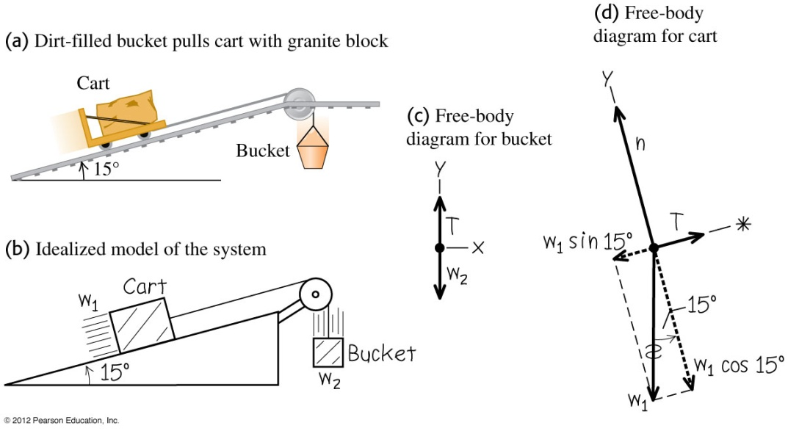
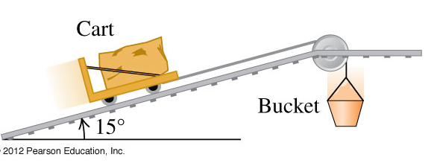
Example 8
A granite block on a cart with steel wheels (total weight of block and cart is w₁) is pulled uphill (angle of inclination is 15º) on steel rails by a dirt-filled bucket (total weight of dirt and bucket is w₂) that descends vertically downwards (see figure). How must the weights w₁ and w₂ be related in order for the system to move with constant speed? Ignore friction in the pulley and wheels and ignore weight of the cable.
Notes:
w₂ = w₁ sin15º = 0.26 w₁

Slide 26
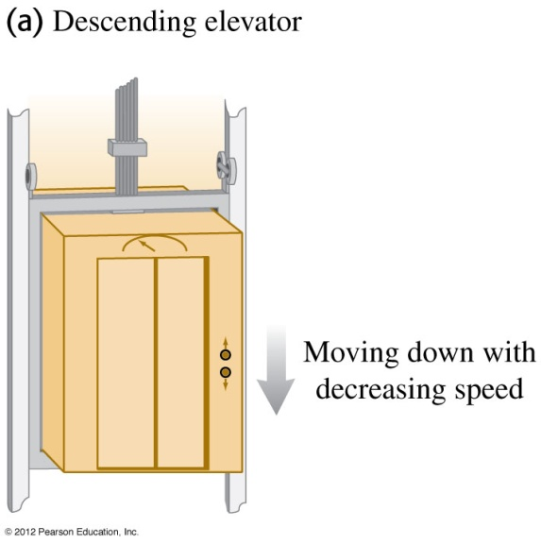
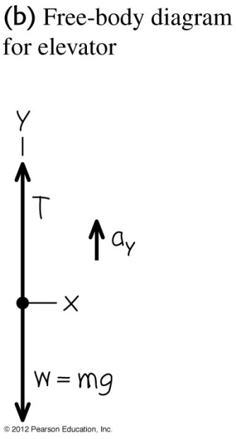
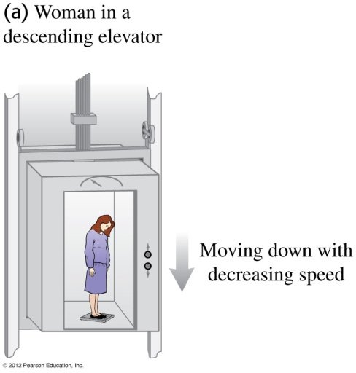
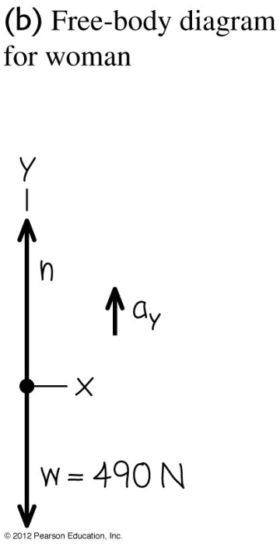
Example 9
(a) An elevator and its load have a combined mass of 800 kg. The elevator is initially moving downward at 10.0 m/s ; it slows to a stop with constant acceleration in a distance of 25.0 m. What is the tension T in the supporting cable while the elevator is being brought to rest?
(b) If a 50.0 kg woman stands on a bathroom scale while riding in the elevator. What is the reading on the scale?
Notes:
(a) Tension = 9440 N
(b) Reading on the scale = 590 N

Slide 27
Kinetic friction forces
When an object moves on a surface, the friction force that acts is known as kinetic friction force (f_{k}).
In some scenarios the kinetic friction force is approximately proportional to normal force (N) and can be represented as
Note that the above equation is a scalar equation.
µ_{k} is known as the coefficient of kinetic friction.

Slide 28
Static friction forces
Friction forces may also act even there is no relative motion. This friction is called a static friction force f_{s}.
The static friction force on a stationary object increases until a maximum value before the objects starts moving.
The maximum static friction force is represented as
where µ_{s} is known as the coefficient of static friction. Note that µ_{s} > µ_{k}.

Slide 29
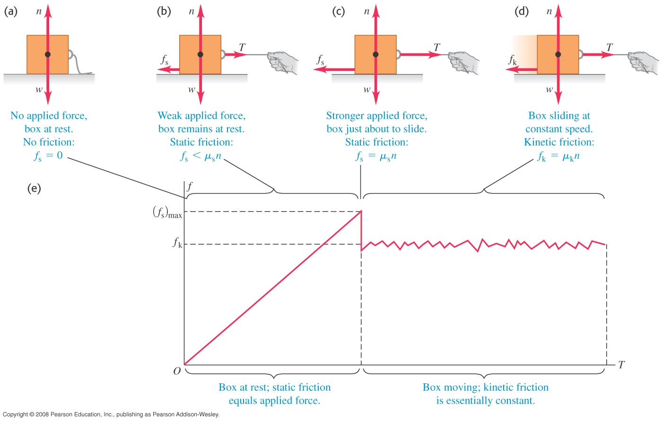
Friction forces
The below figures indicate the different scenarios and the friction forces involved.

Slide 30
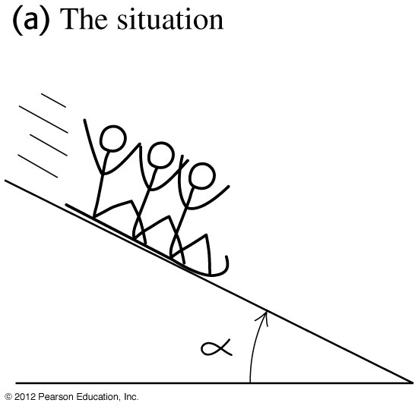
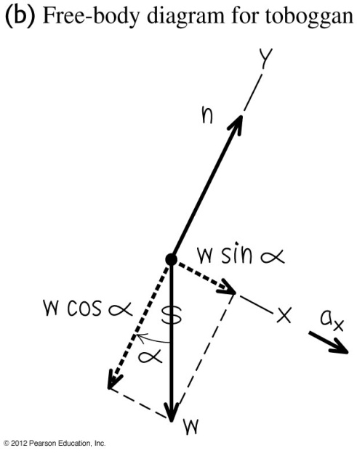
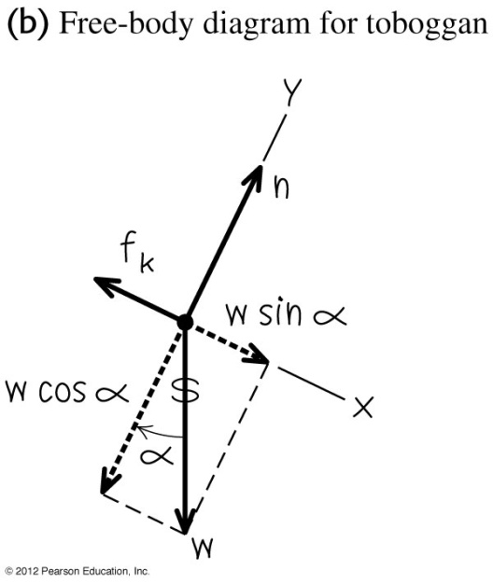
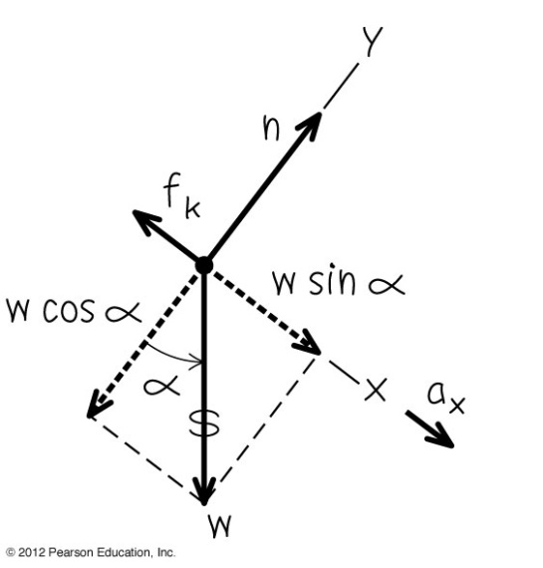
Example 10
A toboggan loaded with students (total weight w) slides down a snow-covered slope.
i) Assuming no friction what is the acceleration of toboggan if the hill slopes at a constant angle α?
ii) Assuming friction with coefficient of kinetic friction µ_{k}, what should be the angle so that the toboggan slides at constant velocity?
iii) Assuming friction with coefficient of kinetic friction µ_{k}, what should be the acceleration of the toboggan in terms of α , µ_{k ,} g and w?
Notes:
(i) a = g sin α, (ii) α = tan⁻¹(µ_{k}), (iii) a = g (sin α - µ_{k} cos α)

Slide 31
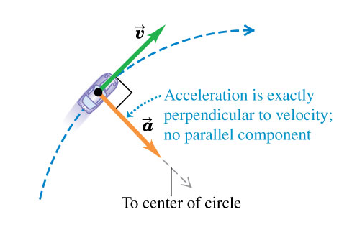
Uniform circular motion
When a particle moves in a circle with constant speed, the motion is called uniform circular motion.
There is only the perpendicular component of acceleration, directed inward, which is a result of the change in direction of the particle.

Slide 32
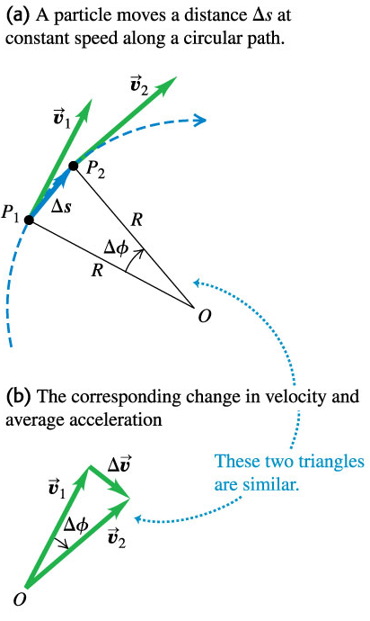
Uniform circular motion
The angle ∆ϕ is the same for the two triangles because is perpendicular to line OP₁ while is perpendicular to line OP₂.
Since the two triangles are similar and ,

Slide 33
Centripetal acceleration
The magnitude of the average acceleration is
The magnitude of the instantaneous acceleration is

Slide 34
Centripetal acceleration and time period
If period T is the time taken by the particle to complete one revolution, then the particle travels a distance equal to the circumference, i.e,
The centripetal acceleration can be written in terms of T as

Slide 35
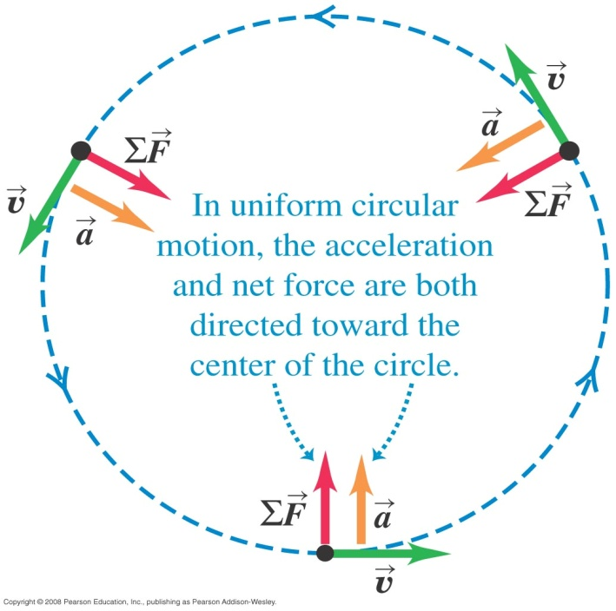
If the centripetal acceleration is there then by Newton’s second law, a net force must be present.
We call this net force as the centripetal force and it acts towards the centre (see figure).
Its magnitude is given by

Slide 36
Some useful things to remember
The centripetal acceleration
is a vector.
is directed towards the centre of the circular path.
prevents the particle from travelling in a tangential direction.
The centripetal force
is a single force or a combination of forces with a resultant towards the centre of the circular path.
is perpendicular to the displacement of the particle and does no work on the particle.

Slide 37
Example 11
a) An object moves along a circle or a circular arc with a constant speed is accelerating.
i) Why is it accelerating?
ii) What is its acceleration?
b) For a body to move in a circular path, a force must act on it from outside the body.
i) What is this required force?
ii) What is providing this required force?
Notes:
The direction of the velocity is changing due to the net force which is the centripetal force b) v²/R
b) The required force or the net force is the centripetal force if it moves at a constant force. b)Tension, gravity etc together may add up to centripetal force. For a non-uniform circular motion the net force is a result of the centripetal and tangetial forces.

Slide 38
Example 12
When an aircraft is moving in a horizontal plane at a constant speed of 650 m/s, its turning circle has a radius of 80 km. What is the ratio of the centripetal force to the weight of the aircraft? Take g = 9.80 m/s².

Slide 39
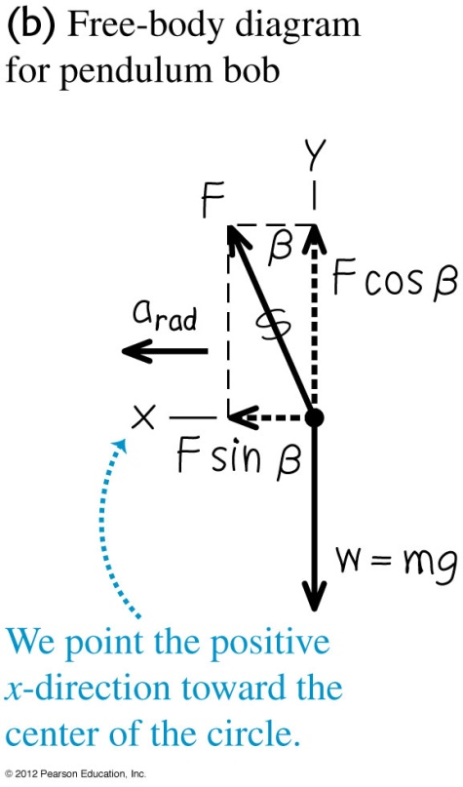
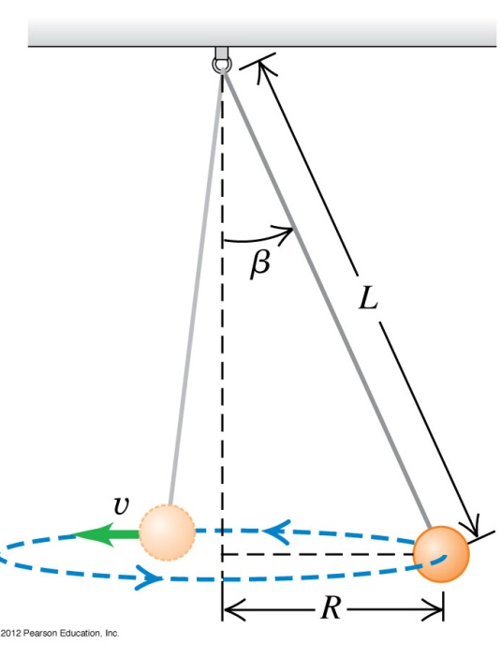
Example 13
A inventor designs a pendulum clock using a bob with mass m at the end of a thin wire of length L. Instead of swinging back and forth, the bob is to move in a horizontal circle with constant speed v with the wire making a fixed angle β with the vertical direction (see figure). This is called a conical pendulum because the suspending wire traces out a cone. Find the tension F in the wire and the period T (the time for one revolution of the bob).
Notes:
F = mg/cos β, T = 2π√(L cos β/g)

Slide 40
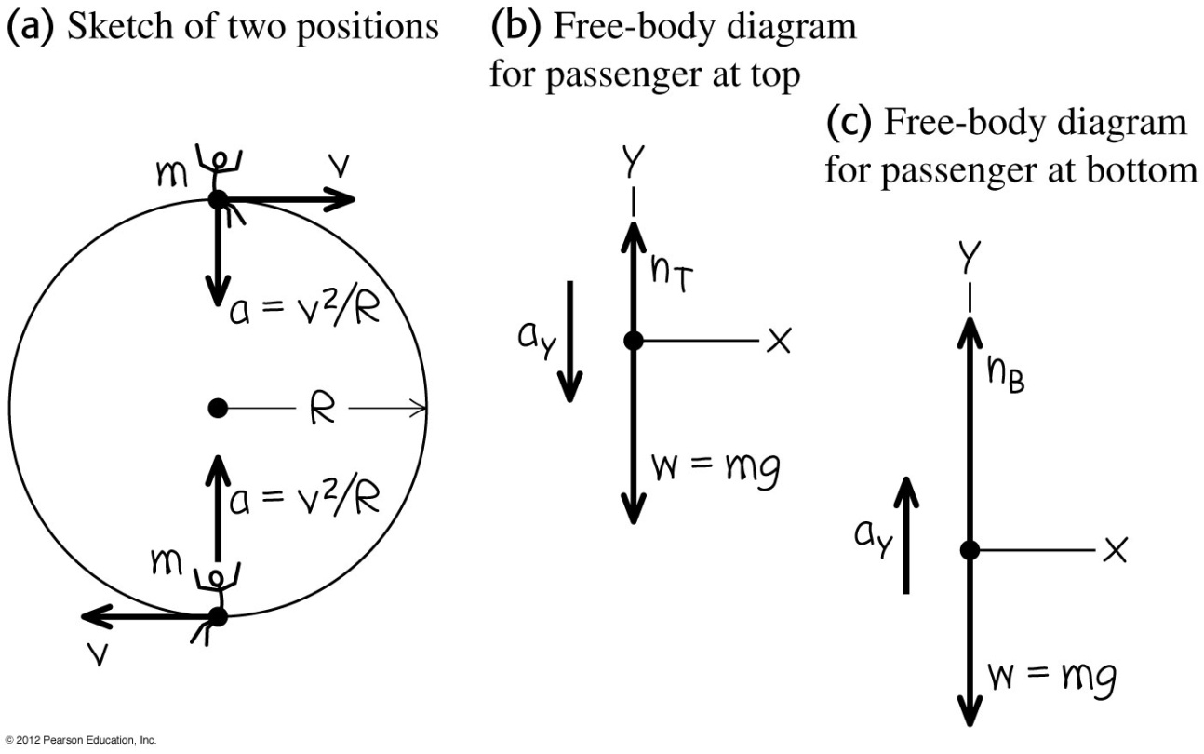
Example 14
A passenger on a carnival Ferris wheel moves in a vertical circle of radius R with constant speed v. The seat remains upright during the motion. Find expressions for the force the seat exerts on the passenger at the top of the circle and at the bottom.
Notes:
Top: N_{top} = mg (1 – v²/gR), Bottom: N_{bottom}= mg (1 + v²/gR)

Slide 41
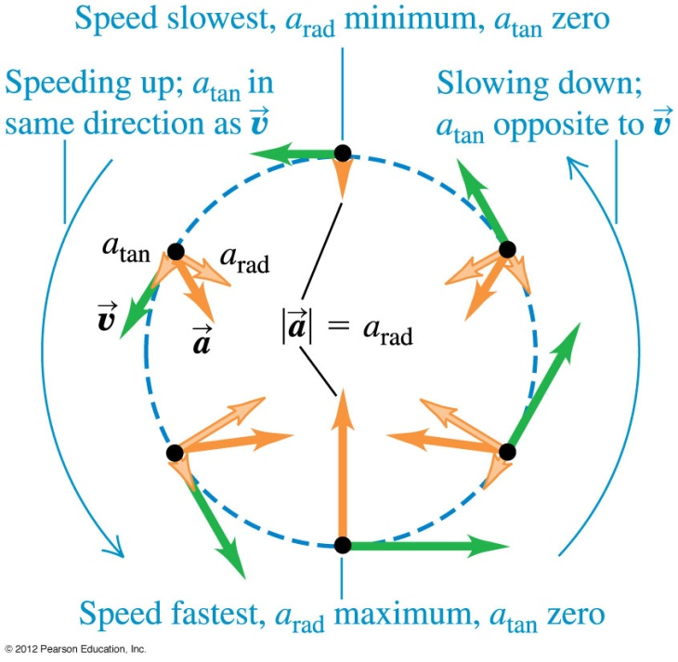
Non-uniform circular motion
If the speed of the particle on a circle varies the motion, it is termed as non-uniform circular motion.
In this motion, there will also be a tangential acceleration component, a_{tan} that is parallel to the instantaneous velocity given by
The total acceleration is therefore

Slide 42
Example 15
A car exhibits a constant acceleration of 3.00 m/s² parallel to the roadway. The car passes over a rise in the roadway such that the top of the rise is shaped like a circle of radius 50.0 m. At the moment the car is at the top of the rise, its velocity vector is horizontal and has a magnitude of 6.00 m/s. What are the magnitude and direction of the total acceleration vector for the car at this instant?
3.00 m/s²
θ
a m/s²
0.72 m/s²

Slide 43
Optional Slides

Slide 44
Fluid resistance force
If an object moves in fluids, it experiences resistance.
For small objects with very low speeds the magnitude of the fluid resistance force f depends directly on the velocity as
where k is a constant that depends on the shape and size of the body and properties of the fluid.
Examples include dust particles falling in air or a ball bearing falling in oil.

Slide 45
Terminal velocity
Consider a metal ball falling in oil such that the resistance force is .
According to Newton’s second law
As the ball falls, the speed will increase which will also increase the resistance force.
At a certain point of time, the weight of the object will equal the resistance force.

Slide 46
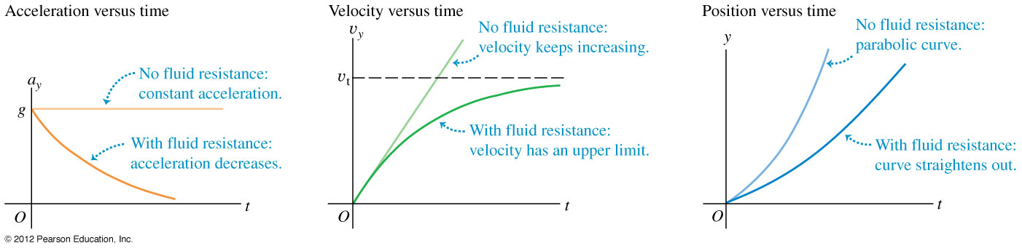
Terminal velocity – detailed calculation
Consider a metal ball falling in oil such that the resistance force is .
Solving the above equation with v_{y} = 0, when t = 0, we get

Slide 47
Air drag
For larger objects moving through air at high speeds, the resisting force is approximately proportional to v².
This kind of resisting force is called air drag or simply drag. Airplanes, falling rain drops and bicyclists all experience air drag.
Air drag can be expressed as
where ‘D’ is a constant that depends on the shape and size of the body and the density of air.
The terminal velocity of objects under air drag is given by

Slide 48
End of chapter

